Slide 1
Forbes List vs Wikipedia Pageviews
An exploration in correlation

Slide 2
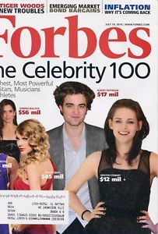
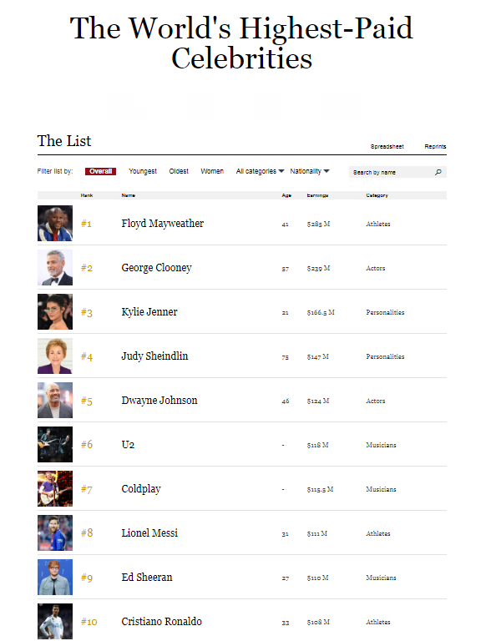
The Forbes Celebrity 100
Forbes compiles an annual list of the world's highest paid celebrities.
The list has been published since 1999.

Slide 3
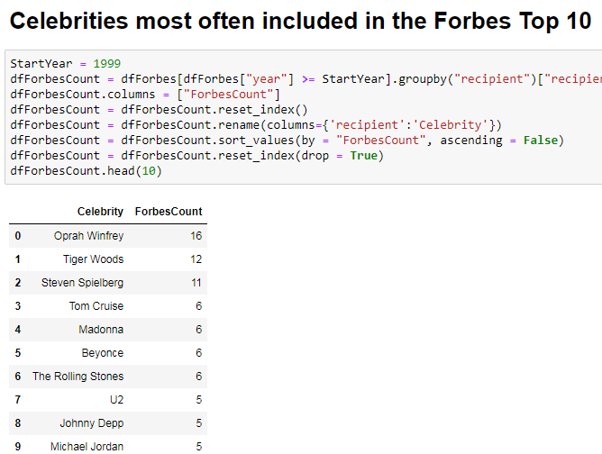
The Best of the Best
To be cited in the Forbes list is already a great honor for any celebrity. But even in this elite group, there are over-achievers.
From the annual list of 100, let's look at only the top 10.
And from the annual top 10, let's see who's been included the most.

Slide 4

Wikipedia Pageviews
Wikipedia was launched in 2001 and quickly became the default free encyclopedia.
Anyone can access and contribute freely.
Since 2016, Wikipedia has made it's page view statistics available.

Slide 5
Forbes List as a Predictor of Wikipedia Page Views?
Throughout the Forbes List history, there have been 82 celebrities (or groups of celebrities) that made it to the top 10.
One convenient trait they share is that they ALL have dedicated Wikipedia pages.
While the Forbes list is a good indicator of a celebrity's financial standing, it is interesting to ask if the Forbes List predicts their Wikipedia page views.
We can state this hypothesis more simply:
Is it true that the higher the celebrity's "Forbes Count", the higher his or her page view in Wikipedia?

Slide 6
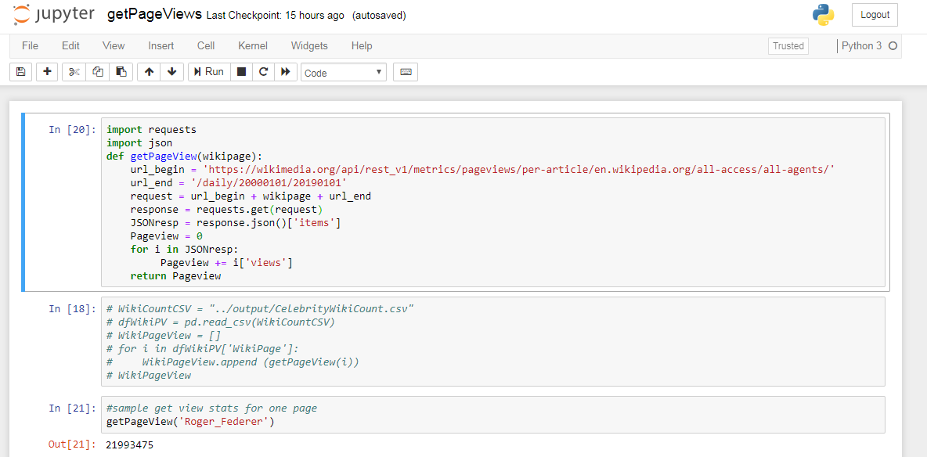
Getting the Page View Counts
We use a Jupyter notebook running on Python to harvest Wikipedia page statistics.

Slide 7
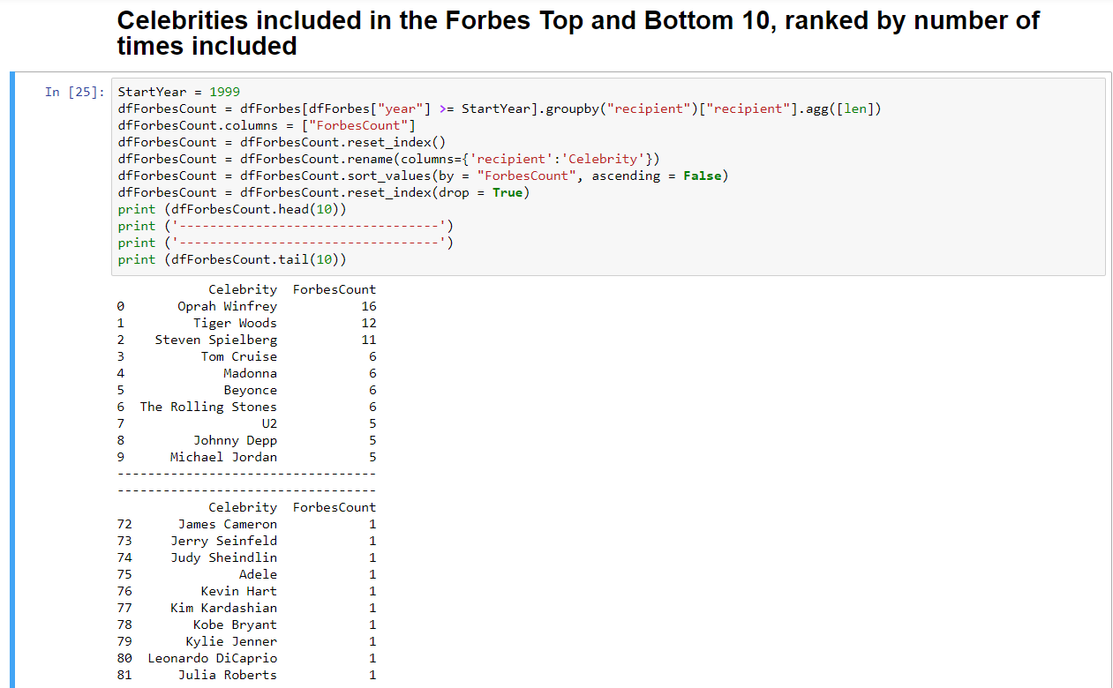
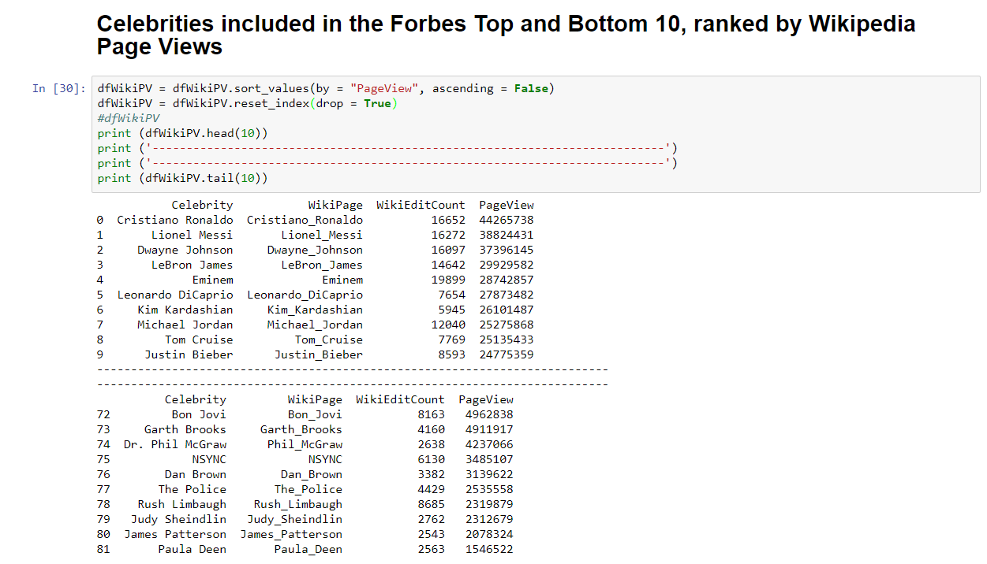
Ranking the Same List of 82 Celebrities

Slide 8
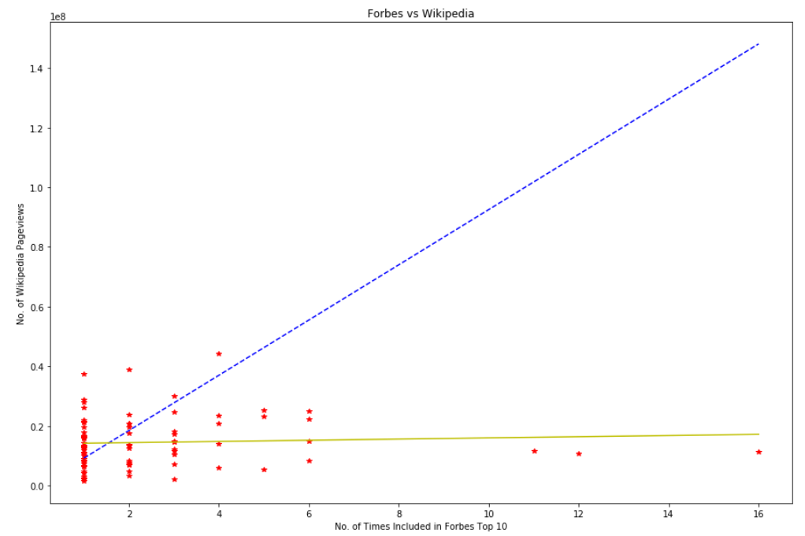
Making a Scatter Plot with Linear Regression
At the extremes, the two lists are ordered differently. This already gives an instinctive feeling of no correlation.
Exactly how false our hypothesis is, is something we can determine through analysis.
We create a scatter plot of all 82 celebrities (red), and determine the best straight line with minimal distance from each point (in yellow). This represents our actual correlation.
For contrast, ideal positive correlation is shown in blue.

Slide 9
R-value, P-value, Correlation, Catch
R-value (-1 to +1) measures how close the two variables (Forbes count and Page view) follow each other. An r-value close to zero indicates no correlation.
P-value (0 to 1) indicates how likely our data was a product of randomness. The higher the p-value, the more likely it is by pure chance.
Both our computed r and p values suggest that our hypothesis is false.
In other words, the number of times a celebrity has been included in the Forbes Top 10 list does not predict his or her Wikipedia page views.
However, there is a catch. An inherent bias in our data may be affecting our results. The next slides explore what's wrong.

Slide 10

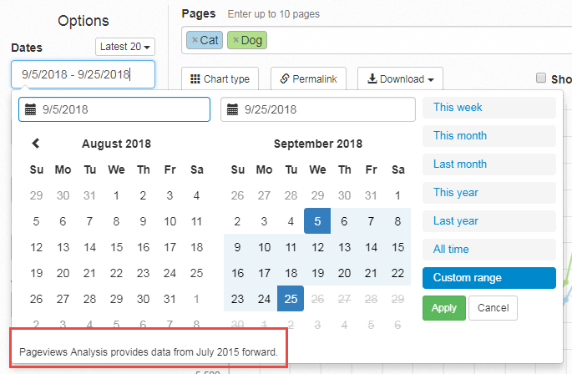
Data Bias
The Pageviews API from Wikipedia only provides data from July 2015 forward.
This creates a bias in favor of more recent celebrities because the pageviews from 1999 to 2014 are not counted.

Slide 11
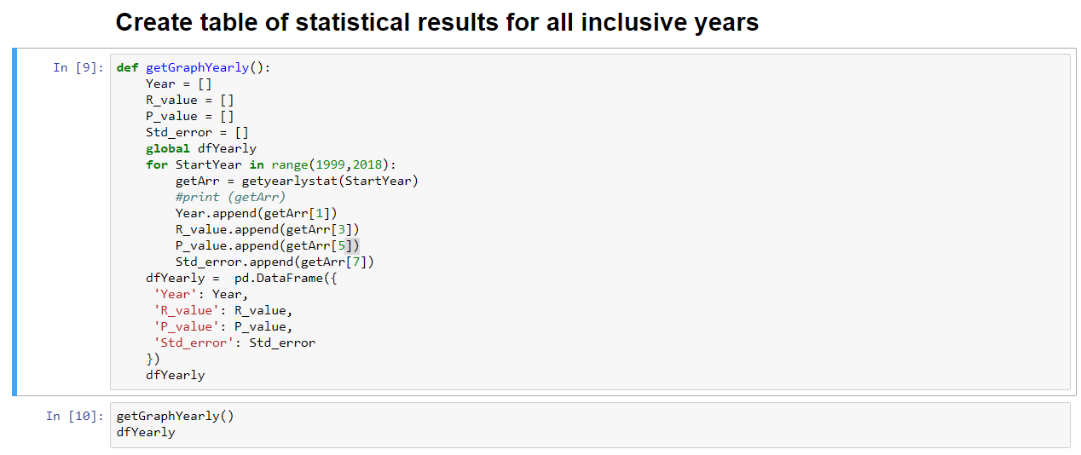
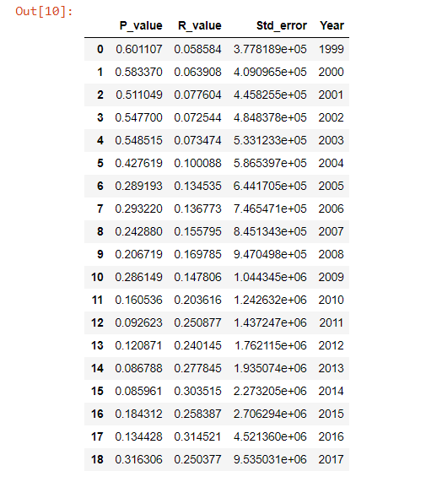
Determining Trend of R-value Over Years
If our data and results are not valid for year range (1999 to present), are there any year ranges when they start becoming valid?
We create a function that iterates over the data, increasing the "StartYear" with each step.

Slide 12
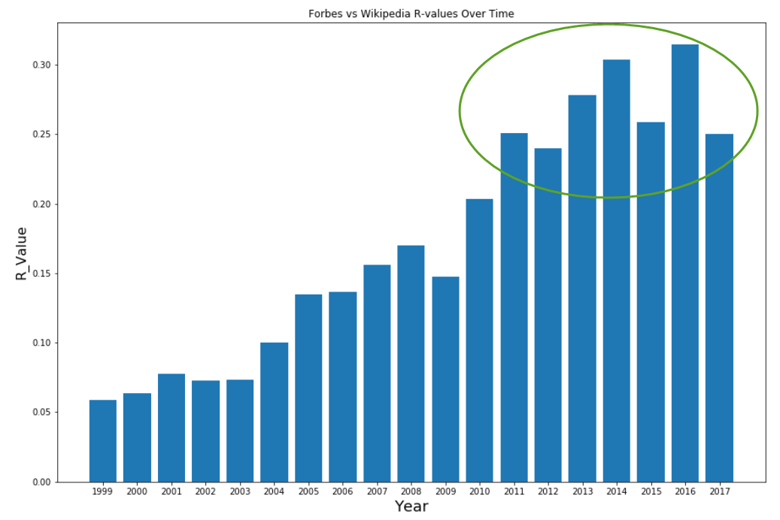
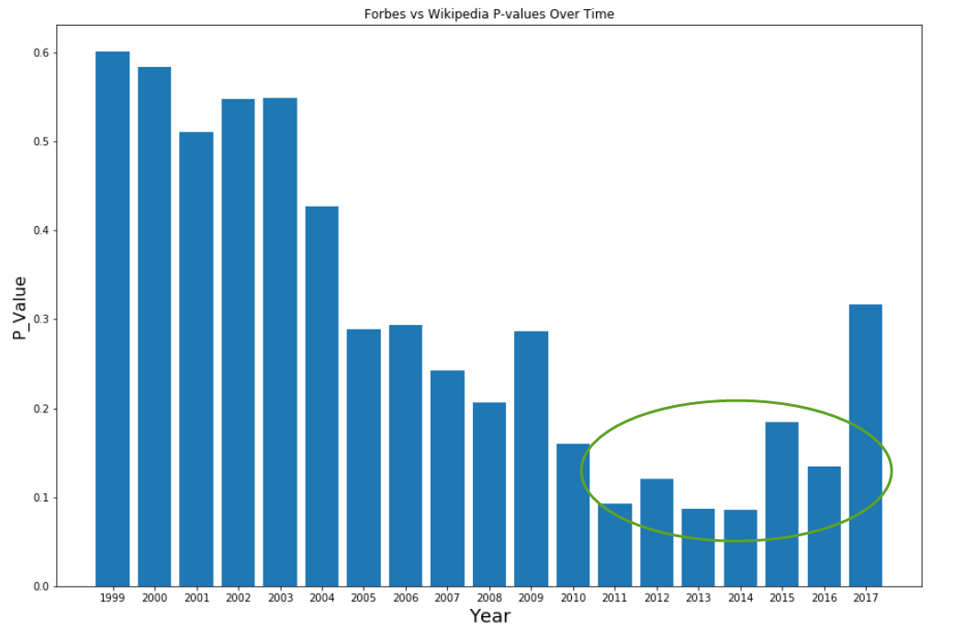
Increasing Correlation Over Time
The results seem positive. We see an increasing correlation of Forbes and Wikipedia data over time.
More significantly, from "no correlation", our graph achieves "weak correlation" on year 2010.
We also see a significant decrease in P-value around the same year.
Correcting for data, our results now suggest weak correlation.

Slide 13
Acknowledgements
This small presentation was created with advise and inspiration from DIY Data Workshop facilitated by Dr. Reina Reyes, 2018, Shaw Boulevard, Mandaluyong, Metro Manila.
Forbes List data prepared by Reina Reyes.
Pageview data prepared by Jesus Chua Jr.
Subjective rule-of-thumb used in categorizing R-value correlation:
0.00-0.19: very weak
0.20-0.39: weak
0.40-0.59: moderate
0.60-0.79: strong
0.80-1.00: very strong
Source: https://www.researchgate.net/post/What_is_the_minimum_value_of_correlation_coefficient_to_prove_the_existence_of_the_accepted_relationship_between_scores_of_two_of_more_tests
There is a noticeable decrease in R-value in year 2017, and a corresponding spike in P-value. This is most likely caused by the sample size being too small. At year range 2017-present, there are only 18 celebrities at play.

Slide 14
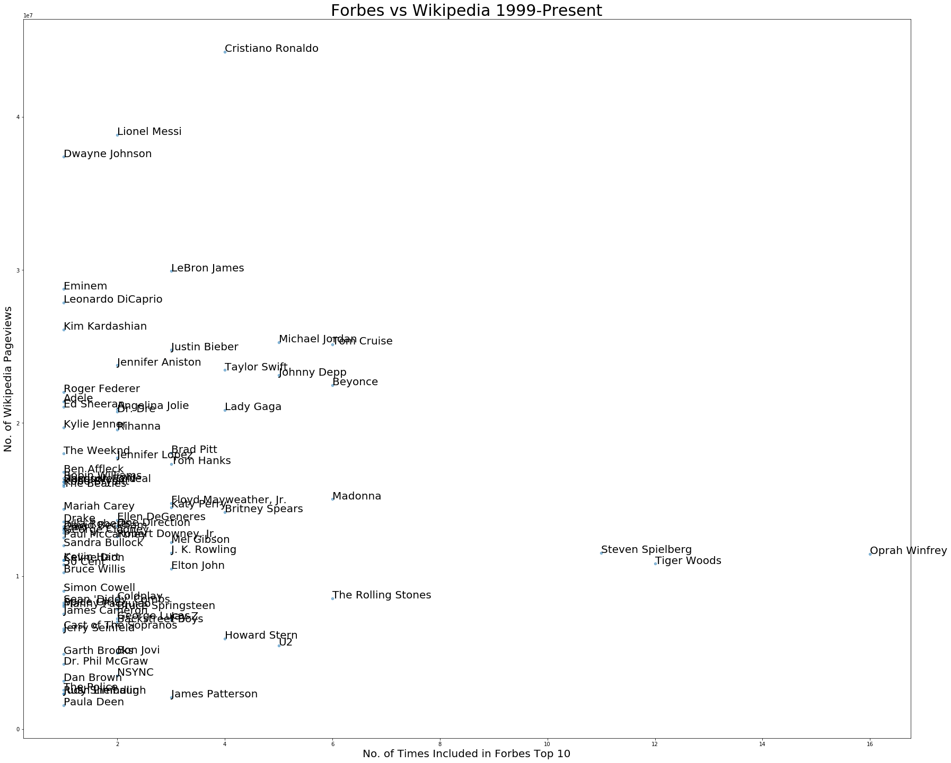
Original Scatter Plot with Names

Slide 15
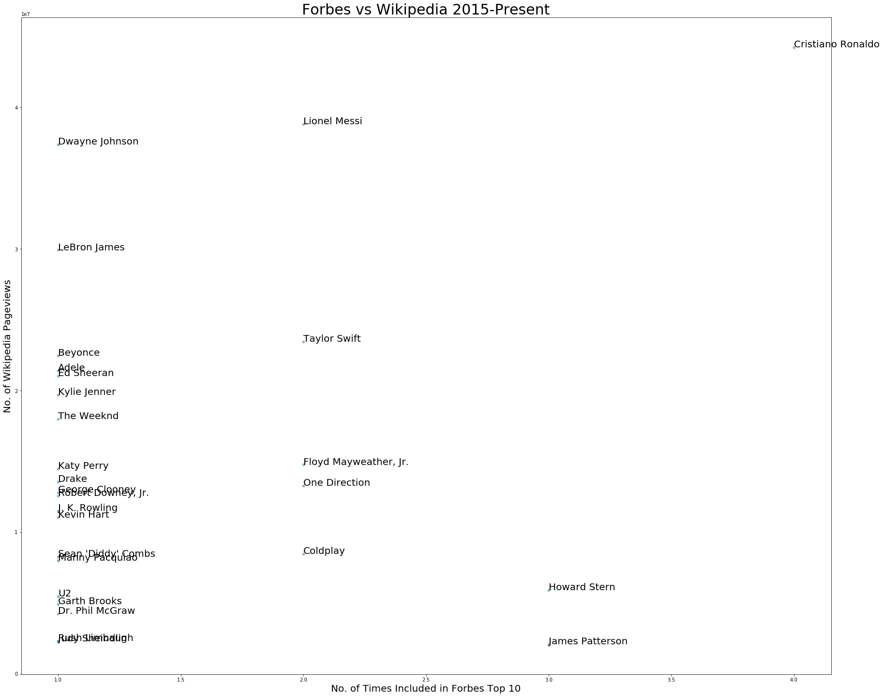
Data-Corrected Scatter Plot

Slide 16
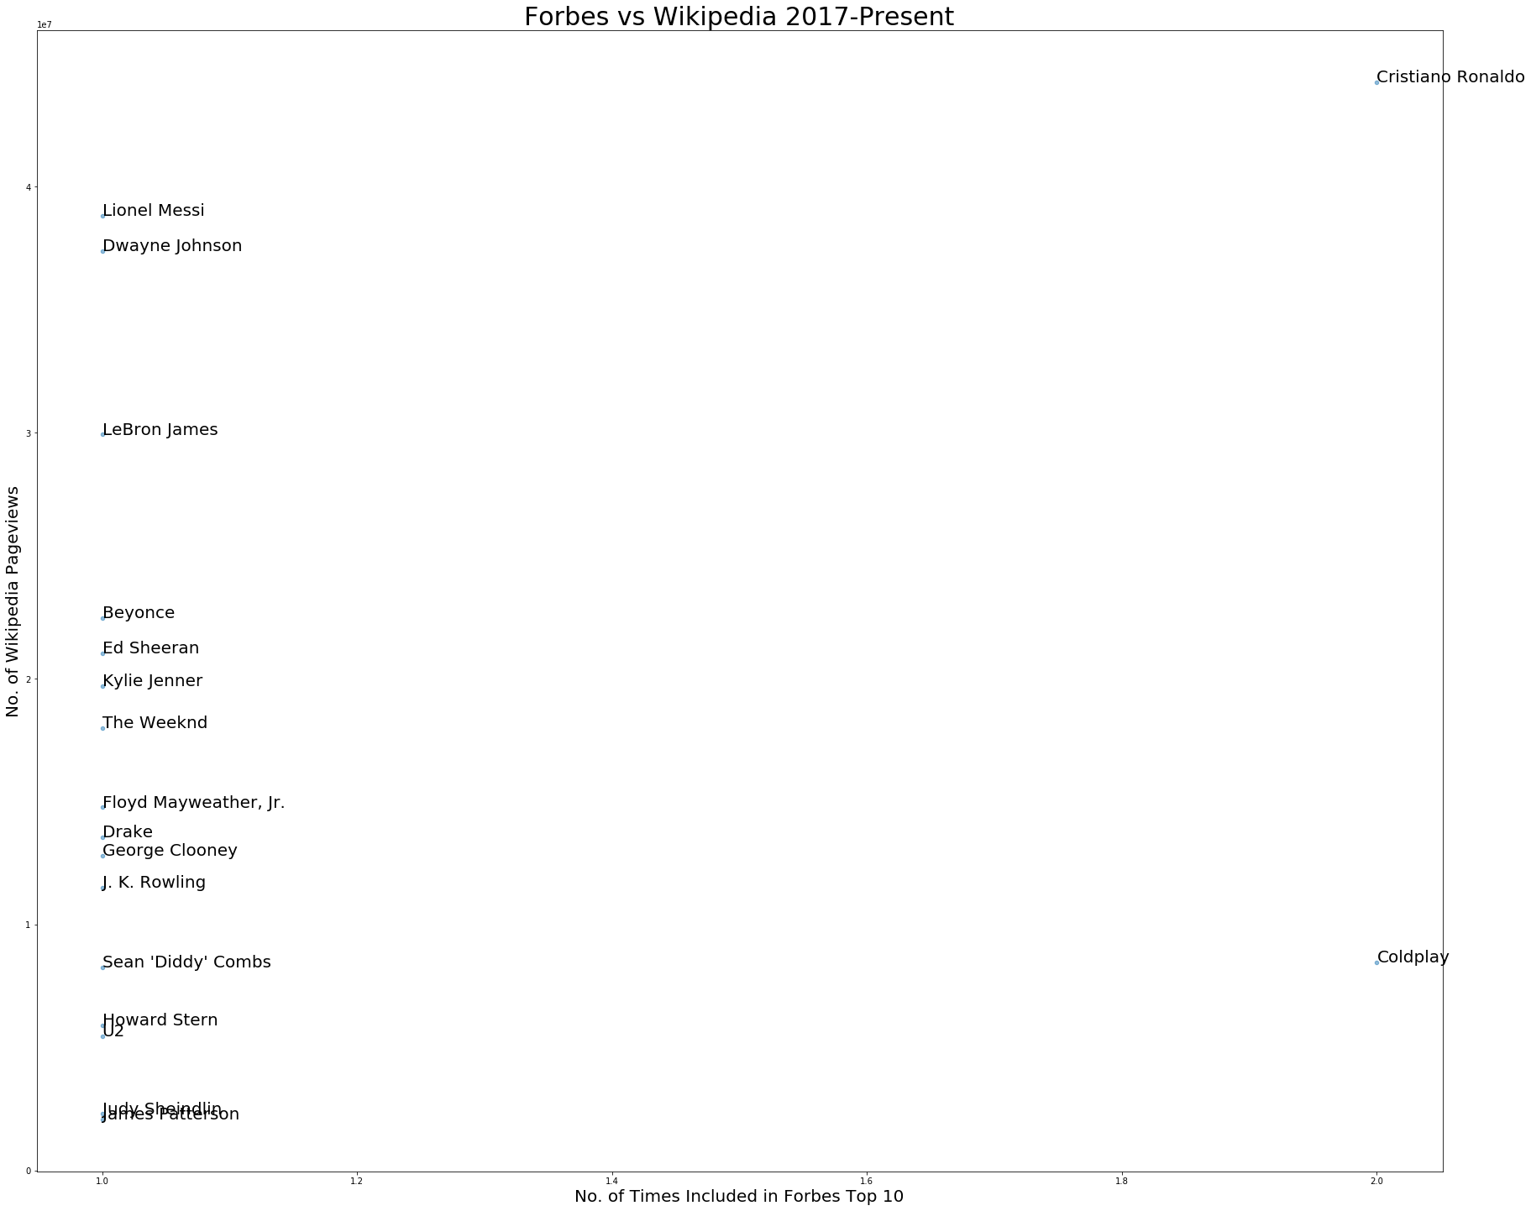
Scatter Plot with too small sample size

Slide 17
Thank you for your time

